Slide 1
ABC (ALWAYS BE IN CONTROL)
AN EDUCATIONAL GUIDE TO PREVENT AND REDUCE ALCOHOLISM

Slide 2
OVERVIEW
Target Population
Flyers
Alcoholism
Risk factors
Signs and Symptoms
Understanding Alcohol Use Disorder
What is Binge Drinking?
Risk Factors
Signs and Symptoms
Vaping/ Tobacco Use and Alcohol
Substance Use and Alcohol
Covid-19 and Alcohol
Mental Health and Alcohol
Treatment
Where to Find Help

Slide 3
TARGET POPULATION: ANYONE AGED 15-24 YEARS OLD WHO ARE LIVING IN DURHAM, NC AND THE SURROUNDING AREAS.

Slide 4
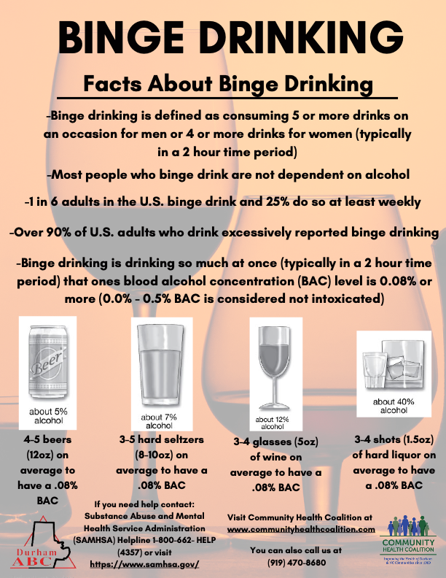
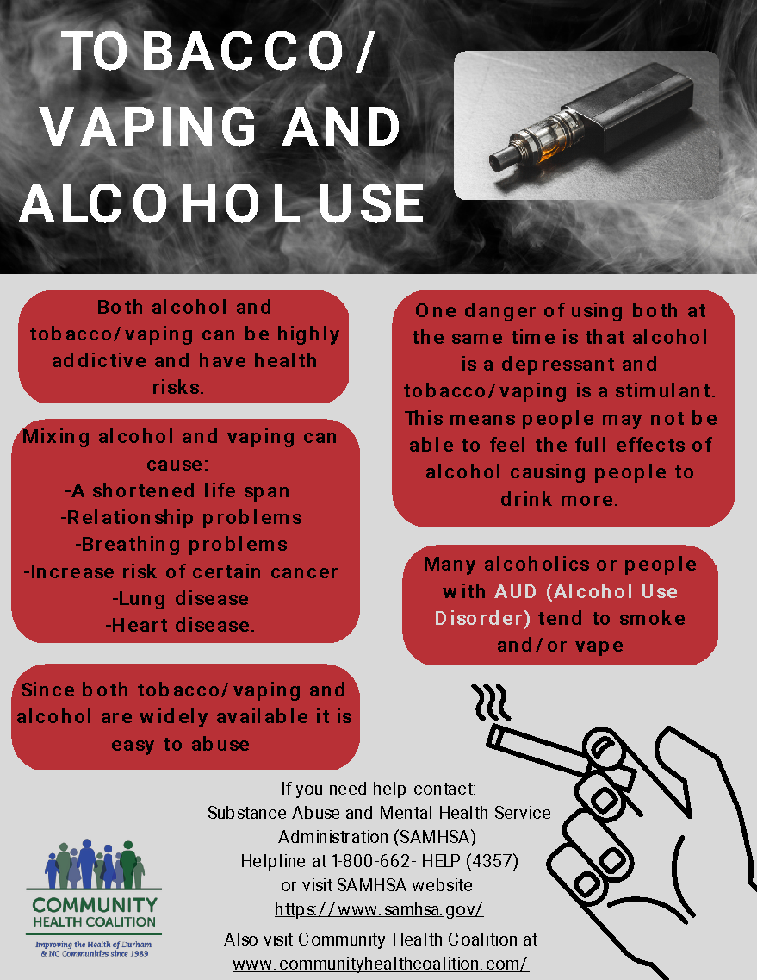
FLYERS

Slide 5
WHAT IS ALCOHOLISM?
A chronic disease where a person craves drinks that contain alcohol and are unable to control their drinking
Typically, a person with this disease needs to drink a greater amount to get the same effects
If the person stops drinking alcohol, they may experience withdrawal symptoms

Slide 6
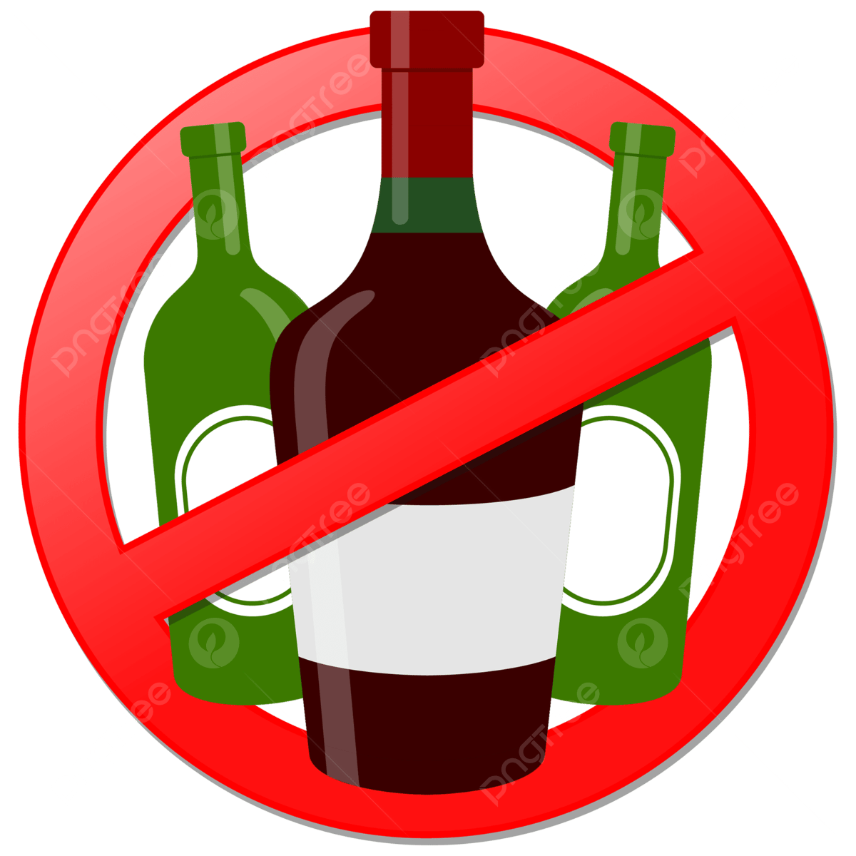
RISK FACTORS OF ALCOHOLISM
Starting to drink at an early age
Having a family history of alcoholism
Depression and other mental health problems
Having a history of trauma
Certain social and cultural factors (Examples: having friends who drink regularly, drinking being portrayed on social media, or influence or parents/peers/other role models)

Slide 7
SIGNS AND SYMPTOMS OF ALCOHOLISM
Being unable to limit the amount of alcohol you drink
Wanting to cut down on how much you drink but being unsuccessful
Spending lots of time drinking, buying or recovering from alcohol use
Strong cravings or urge to drink alcohol
Unable to fulfill obligations at work, school or home due to alcohol use
Continuing to drink regardless of the physical, social, work, or relationship problems
Using alcohol in unsafe situations (Ex: driving)
Developing a tolerance to alcohol
Experiencing withdrawal symptoms when you don’t drink

Slide 8
UNDERSTANDING ALCOHOL USE DISORDERS
This is also known as AUD
It is a medical condition characterized by an impaired ability to stop or control alcohol use despite the consequences (social, occupational, and health)
This includes the conditions alcohol dependence, alcohol addiction, and alcoholism
AUD can be mild, moderate, or severe
A person's risk for developing AUD depends on how much, how often and how quickly alcohol is consumed

Slide 9
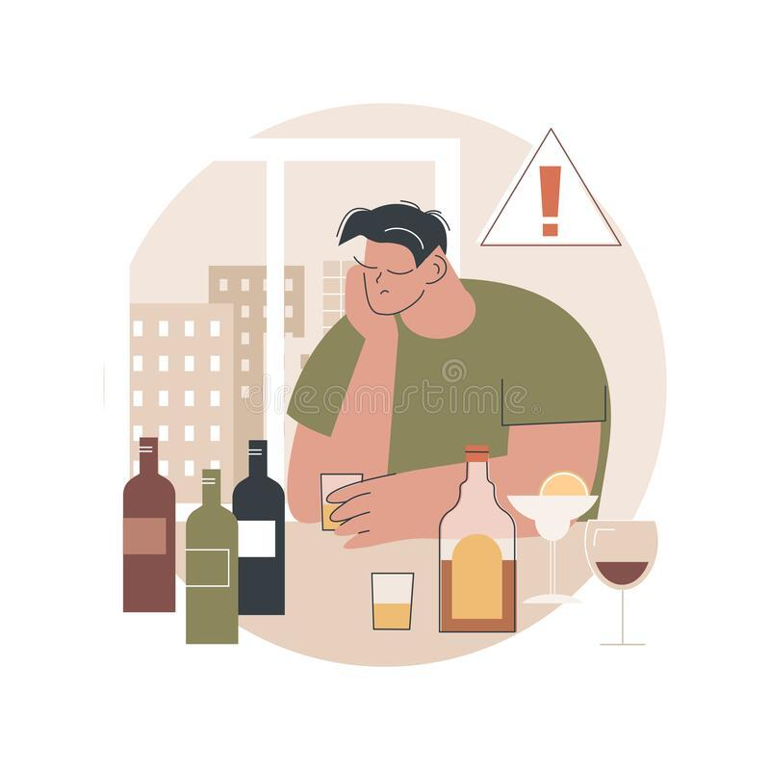
WHAT IS BINGE DRINKING?
Binge drinking is drinking so much at once that your blood alcohol concentration (BAC) level is 0.08% or more (typically in a two-hour time period)
Defined as consuming 5 or more drinks on an occasion for men or 4 or more drinks for women
Most common and costly pattern of excessive alcohol use in the United States
Most people who binge drink are not dependent on alcohol
1 in 6 adults in the US binge drink and 25% do so at least weekly
Over 90% of US adults who drink excessively report binge drinking

Slide 10
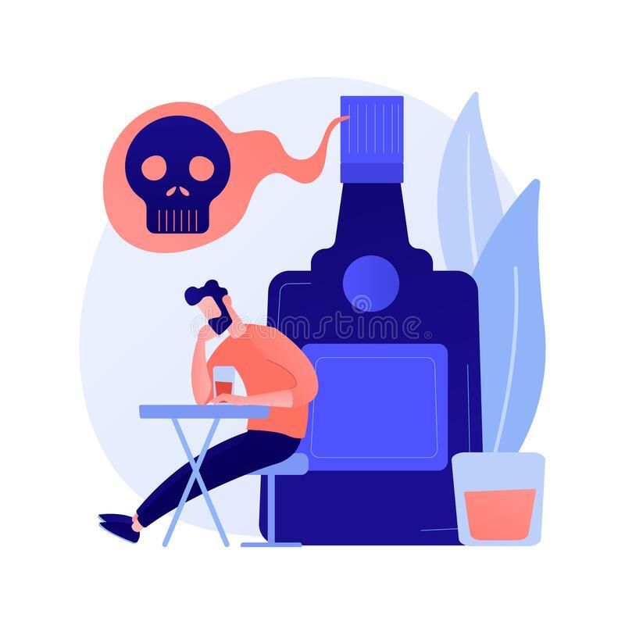
RISK FACTORS OF BINGE DRINKING
Living or socializing in a drinking culture (Example: colleges or in families with heavy drinkers)
Peer pressure, especially among young adults
Low cost and easy access to alcohol
Having poor coping skills
Experiencing trauma
Depression and anxiety

Slide 11
SIGNS AND SYMPTOMS OF BINGE DRINKING
Having strong cravings for alcohol
Inability to cut down on alcohol use
Significant efforts to get alcohol, drink, or an increase amount of time needed to recover from drinking
Alcohol use causes the inability to complete tasks at home, school, and/or work
Using alcohol despite it causing social and interpersonal issues
Avoiding social, work, and other activities due to alcohol

Slide 12
VAPING AND TOBACCO USE RELATING TO ALCOHOL USE
Both alcohol and tobacco/vaping can be highly addictive and have health consequences
Mixing these can cause a shortened life span, interpersonal problems, respiratory problems, increase risk of certain cancers, lung disease and heart disease
Many alcoholics or people with AUD tend to smoke or vape
One danger of using both at the same time is that one is a depressant (alcohol), and the other is a stimulant (tobacco/vaping)
Since alcohol is a depressant and the tobacco a stimulant, people may not feel the full affects of the alcohol causing people to drink more
Since both tobacco/vaping and alcohol are widely available it is easy to abuse

Slide 13
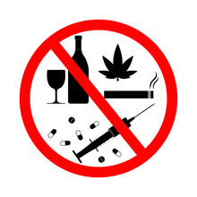
SUBSTANCE USE RELATING TO ALCOHOL USE
Using alcohol with other substances (opioids, marijuana, medications not prescribed) is unsafe because the effects may be stronger and more unpredictable
Polysubstance use is when two or more substances are being used together or within a short time period
Health risks include overdose, injuries, violence, risky sexual behaviors, chronic disease, and developing an AUD or substance use disorder
If using another depressant (opioids or others) together or within a few hours of drinking can result in difficulty breathing, and damage to the brain, heart, and other organs.

Slide 14
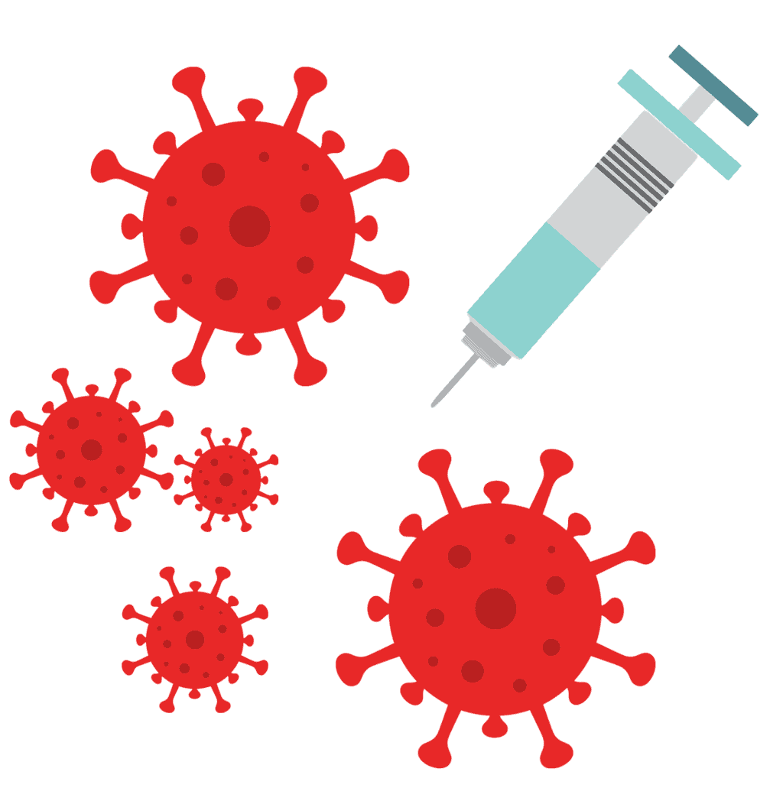
COVID-19 RELATING TO ALCOHOL USE
During the pandemic alcohol consumption increased
Due to the year long increase it is estimated to cause 8,000 additional deaths from alcohol related liver disease, 18,700 cases of liver failure, and 1,000 cases of liver cancer by the year 2040
By this year, 2023, this is expected to cause 100 additional deaths, and 2,800 additional cases of liver failure
Using alcohol to cope with the stress and anxiety of Covid-19 may cause more anxiety, loneliness (isolation/quarantine), and alcohol negatively affects the immune system

Slide 15
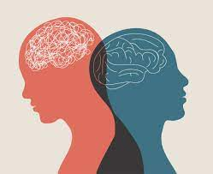
MENTAL HEALTH RELATING TO ALCOHOL USE
Men and women who report high levels of stress tend to drink more
Men tend to turn to alcohol to cope with stress more than women do
Anxiety and AUD are common co-occurring disorders
AUD can make an already existing anxiety disorder worse or lead to new anxiety symptoms
Chronic alcohol use can affect the ability to respond to stress in a healthy way
Alcohol can also make depression symptoms worse

Slide 16
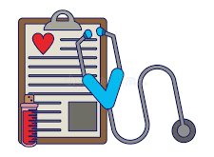
TREATMENT
Behavioral treatments- aimed at changing drinking behavior through counseling led by health professionals
Medications- there are 3 medications currently approved in the US to help reduce drinking and prevent relapse (can be used alone or in combination with counseling)
Support groups- Alcoholics Anonymous (AA) and other 12-step programs that provide peer support

Slide 17
WHERE TO FIND HELP
Substance Abuse and Mental Health Service Administration (SAMHSA) National Helpline: 1-800-662-HELP (4357)
Suicide and Crisis Hotline: call or text 988
Emergency assistance: 911
Poison Control: 1-800-222-1222
Talk to a Primary Care provider if you need help

Slide 18
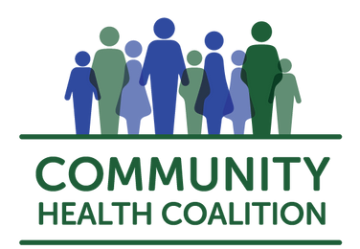
COMMUNITY HEALTH COALITION
CHC provides FREE health tips, blood pressure checks, glucose screenings, community health education workshops and lots of brochures and pamphlets about chronic diseases
Email contact@communityhealthcoalition.com or visit https://www.communityhealthcoalition.com/ for more information!

Slide 19
REFERENCES
988 suicide & crisis lifeline. SAMHSA. (n.d.). Retrieved January 20, 2023, from https://www.samhsa.gov/find-help/988
Alcohol anxiety: Can drinking cause anxiety & panic attacks? American Addiction Centers. (2022, September 15). Retrieved January 20, 2023, from https://americanaddictioncenters.org/alcoholism-treatment/anxiety
Alcohol consumption during the COVID-19 pandemic projected to cause more liver disease and deaths. Massachusetts General Hospital. (n.d.). Retrieved January 20, 2023, from https://www.massgeneral.org/news/press-release/alcohol-consumption-during-the-covid-19-pandemic-projected-to-cause-more-liver-disease-and-deaths#:~:text=In%20the%20short%20term%2C%20alcohol,19%E2%80
Binge drinking effects, risks & dangers. American Addiction Centers. (2023, January 11). Retrieved January 20, 2023, from https://americanaddictioncenters.org/alcoholism-treatment/binge-drinking-problem
Centers for Disease Control and Prevention. (2022, July 25). Alcohol and other substance use. Centers for Disease Control and Prevention. Retrieved January 20, 2023, from https://www.cdc.gov/alcohol/fact-sheets/alcohol-and-other-substance-use.html
Centers for Disease Control and Prevention. (2022, November 14). Binge drinking. Centers for Disease Control and Prevention. Retrieved January 20, 2023, from https://www.cdc.gov/alcohol/fact-sheets/binge-drinking.htm
Coronavirus (COVID-19) & Alcoholism. Alcohol.org. (2022, December 13). Retrieved January 20, 2023, from https://alcohol.org/resources/coronavirus-and-alcoholism/
Gilmerm. (2022, September 22). Why you shouldn't rely on alcohol during times of stress. Cleveland Clinic. Retrieved January 20, 2023, from https://health.clevelandclinic.org/alcohol-during-times-of-stress/
Mayo Foundation for Medical Education and Research. (2022, May 18). Alcohol use disorder. Mayo Clinic. Retrieved January 20, 2023, from https://www.mayoclinic.org/diseases-conditions/alcohol-use-disorder/symptoms-causes/syc-20369243

Slide 20
REFERENCES (CONTINUED)
NCI Dictionary of Cancer terms. National Cancer Institute. (n.d.). Retrieved January 20, 2023, from https://www.cancer.gov/publications/dictionaries/cancer-terms/def/alcoholism
Samhsa's national helpline: Samhsa - Substance Abuse and Mental Health Services Administration. SAMHSA. (n.d.). Retrieved January 20, 2023, from https://www.samhsa.gov/find-help/national-helpline
Suspect a poisoning? get expert help. use the webpoisoncontrol online tool, or call. both Optio. Poison Control. (n.d.). Retrieved January 20, 2023, from https://www.poison.org/
U.S. Department of Health and Human Services. (n.d.). Alcohol alert. National Institute on Alcohol Abuse and Alcoholism. Retrieved January 20, 2023, from https://pubs.niaaa.nih.gov/publications/AA85/AA85.htm#:~:text=Problems%20arise%2C%20however%2C%20when%20stress,the%20risk%20for%20alcohol%20dependence
U.S. Department of Health and Human Services. (n.d.). Alcohol and tobacco. National Institute on Alcohol Abuse and Alcoholism. Retrieved January 20, 2023, from https://pubs.niaaa.nih.gov/publications/aa71/aa71.htm
U.S. Department of Health and Human Services. (n.d.). Treatment for alcohol problems: Finding and getting help. National Institute on Alcohol Abuse and Alcoholism. Retrieved January 20, 2023, from https://www.niaaa.nih.gov/publications/brochures-and-fact-sheets/treatment-alcohol-problems-finding-and-getting-help
U.S. Department of Health and Human Services. (n.d.). Understanding alcohol use disorder. National Institute on Alcohol Abuse and Alcoholism. Retrieved January 20, 2023, from https://www.niaaa.nih.gov/publications/brochures-and-fact-sheets/understanding-alcohol-use-disorder
What are the effects of mixing tobacco and alcohol? Alcohol.org. (2022, October 25). Retrieved January 20, 2023, from https://alcohol.org/mixing-with/tobacco/

