Slide 1
Youth Against Smoking
An Educational Guide To Prevent And Reduce Substance Use and/or Abuse.

Slide 2
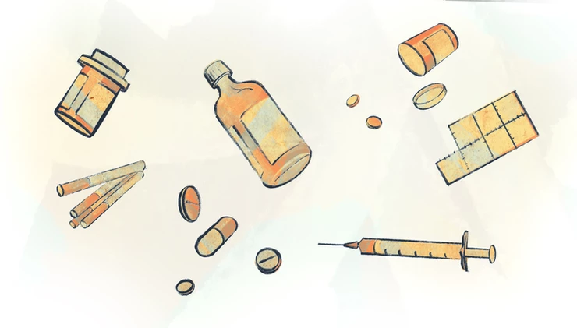
Overview
Target Population
Substance Use Disorder
SUD Continuation…
What Is SUD/Dependence?
Why Is It Important?
How Are Substances Categorized?
Risk Factors
Signs & Symptoms
Treatment/Prevention
When To See A Doctor
Where To Find Help

Slide 3
Target Population
Youth ages 12 to 18 in Durham, North Carolina.
Notes:
Adolescence is a time of transition, and transitions increase the risk of drug misuse. When a teenager moves homes, suffers a divorce in the family, or changes schools, they are more likely to seek out drugs as a coping tool.

Slide 4
Data
This chart represents Tobacco use in the U.S. among Middle School Students in 2020. Each color represents a type of nicotine or smoking product:
BLACK: 6.7% of middle school students reported using any tobacco product.
BLUE: 4.7% of middle school students reported using electronic cigarettes.
BROWN: 1.6% of middle school students reported using cigarettes.
DARK BLUE: 1.5% of middle school students reported using cigars.
GREEN: 1.2% of middle school students reported using smokeless tobacco (snuff and/or chewing tobacco).
GREY: 1.3% of middle school students reported using hookahs.
LIME GREEN: 1.3% of middle school students reported using heated tobacco products.
PURPLE: 0.4% of middle school students reported using pipe products.

Slide 5
Data
This chart represents the current Tobacco product use in the U.S. among High School Students in 2020. Each bar represents the percentage of high school students who stated they used a type of tobacco and/or nicotine. From left to right:
23.6% of high school students stated they used any tobacco product.
19.6% of high school students stated they used e-cigarettes.
5.0% of high school students stated they used cigars.
4.6% of high school students stated they used cigarettes.
3.1% of high school students stated they used smokeless tobacco.
2.7% of high school students stated they used hookah.
1.4% of high school students stated they used heated tobacco products.
0.7% of high school students stated they used pipe tobacco.

Slide 6
What Is SUD (Substance Use Disorder)?
Drug addiction, also called substance use disorder, is a disease that affects a person's brain and behavior and leads to an inability to control the use of a legal or illegal drug or medication (Mayo Clinic, 2017).
Nicotine dependence occurs when you need nicotine and can't stop using it. Nicotine is the chemical in tobacco that makes it hard to quit. Nicotine produces pleasing effects in your brain, but these effects are temporary. So, you reach for another cigarette (Mayo Clinic, 2020).
Substance use disorder occurs when a person's use of alcohol or another substance (drug) leads to health issues and/or problems at work, school, or home (Medline, 2021).
Notes:
Substance abuse refers to a set of related conditions associated with the consumption of mind- and behavior-altering substances that have negative behavioral and health outcomes.
Drug addiction can start with experimental use of a recreational drug in social situations, and, for some people, the drug use becomes more frequent. The risk of addiction and how fast you become addicted varies by drug.

Slide 7
What is SUD/Dependence?
SUD (Substance Use Disorder) is now the medical term for addiction.
Addiction is a treatable, chronic medical disease involving complex interactions among brain circuits, genetics, the environment, and individuals' life experiences (American Society of Addiction Medicine, 2019).
Dependence was a moderate or severe form of addiction.
National Institute of Health states “Dependence means that when a person stops using a drug, their body goes through withdrawal; a group of physical and mental symptoms that can range from mild (if the drug is a caffeine) to life threating (such as alcohol or opioids, including heroin and prescription pain relivers….) (National Institute Of Health,2017).
Notes:
People with addiction use substances or engage in behaviors that become compulsive and often continue despite harmful consequences.
Some drugs, such as opioid painkillers, have a higher risk and cause addiction more quickly than others.
As time passes, you may need larger doses of the drug to get high. Soon you may need the drug just to feel good. As your drug use increases, you may find that it's increasingly difficult to go without the drug. Attempts to stop drug use may cause intense cravings and make you feel physically ill (withdrawal symptoms).

Slide 8
Why Is SUD Important?
According to Healthy People 2020, Substance Abuse has a major impact on individuals, families and communities.
“As cigarette smoking among those under 18 has fallen, the use of other nicotine products, including e-cigarettes, has taken a drastic leap. All of this is creating a new generation of Americans who are at risk of nicotine addiction” (Surgeon General Report, 2016).
Almost 95% of people with substance use problems are considered unaware of their problem (Heathy People, 2020).
“One of the most used highly abused substances among youth in the U.S is alcohol” (Youth.Gov).
Substance Use Disorder is important because it can potentially affect how individuals relate to others and make good healthy choices.
Notes:
Of those who have an addiction, or substance use disorder, 90% of them began using drugs under the age of 18.
Youth engage in binge drinking, a pattern of drinking that elevates the blood alcohol concentration to 0.08 percent or above, more than adults do. This can lead to risky and potentially harmful behaviors, and many times substance abuse (60-75 percent of youth with substance abuse problems) co-occurs with mental health disorders.
In 2005, an estimated 22 million Americans struggled with a drug or alcohol problem (Healthy People, 2020).

Slide 9
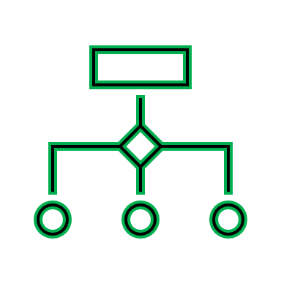
How Are Substances Categorized?
Depressants (Alcohol, beer)
Nicotine (cigarettes, vapes)
Marijuana (cannabis, THC)
Opiates (heroin, codeine, oxytocin)
Prescription medicines (anxiety pills, pain pills)
Stimulants (Cocaine, methamphetamine )
Hallucinogens (mushrooms, ecstasy)
Inhalants (glue, gasoline)
Synthetics (K2/spice, bath salt)
Notes:
Signs and symptoms of drug use or intoxication may vary, depending on the type of drug. Below you'll find several examples.

Slide 10
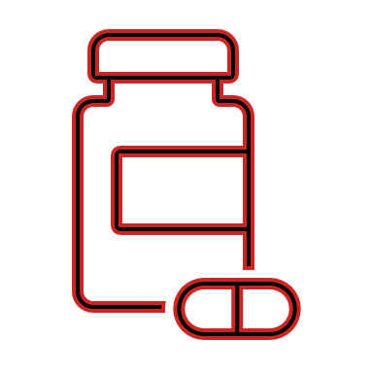
Risk Factors
Everyone is different but, the following factors may increase and/or contribute to the development of an individuals’ drug addiction:
Environmental Factors
Cultural/Societal Factors
Genetics
Family History of Addiction
Mental Health Disorder
Social/Peer Pressure
Lack of Family Involvement
Early Use
Taking a Highly Addictive Drug
Notes:
Another word for risk factors is (causes of the causes).
substance use can be considered normal or acceptable which remains controversial. Substance abuse and dependence are caused by multiple factors. While everyone is susceptible to addiction, there are certain risk and protective factors that influence a person’s likelihood of becoming addicted. FOR EXAMPLE
Environment. Environmental factors, including your family's beliefs and attitudes and exposure to a peer group that encourages drug use, seem to play a role in initial drug use.
Genetics. Once you've started using a drug, the development into addiction may be influenced by inherited (genetic) traits, which may delay or speed up the disease progression.
Family history of addiction. Drug addiction is more common in some families and likely involves genetic predisposition. If you have a blood relative, such as a parent or sibling, with alcohol or drug addiction, you're at greater risk of developing a drug addiction.
Mental health disorder. If you have a mental health disorder such as depression, attention-deficit/hyperactivity disorder (ADHD) or post-traumatic stress disorder, you're more likely to become addicted to drugs. Using drugs can become a way of coping with painful feelings, such as anxiety, depression and loneliness, and can make these problems even worse.
Peer pressure. Peer pressure is a strong factor in starting to use and misuse drugs, particularly for young people.
Lack of family involvement. Difficult family situations or lack of a bond with your parents or siblings may increase the risk of addiction, as can a lack of parental supervision.
Early use. Using drugs at an early age can cause changes in the developing brain and increase the likelihood of progressing to drug addiction.
Taking a highly addictive drug. Some drugs, such as stimulants, cocaine or opioid painkillers, may result in faster development of addiction than other drugs. Smoking or injecting drugs can increase the potential for addiction. Taking drugs considered less addicting — so-called "light drugs" — can start you on a pathway of drug use and addiction.

Slide 11
Signs & Symptoms
Signs and Symptoms of recent use can include:
Depressants: Mood swings, body pains and/or tremors.
Nicotine: Trouble sleeping and increase appetite and/or weight gain.
Marijuana: A sense of euphoria or feeling “high” and/or red eyes.
Opiates: Slurred speech and/or problems with coordination.
Prescription medicines: drowsiness and/or happiness.
Stimulants: Behavior changes or aggression and/or rapid or rambling speech.
Hallucinogens: Flashbacks, a re-experience of the hallucinations-even years later and/or Impulsive behavior.
Inhalants: Dizziness and/or nausea or vomiting.
Synthetics: A sense of euphoria or feeling “high” and/or elevated mood.

Slide 12
Treatment(s) or Prevention
Cognitive Behavior Therapy (CBT): Helps recovering addicts identify their "negative” automatic thoughts.
Contingency Management (CM): Individuals are rewarded for evidence of positive behavioral change.
Motivational Interviewing (CI): Counseling approach that aims to help individuals change problem behaviors.
Notes:
Make an appointment to see a doctor if:
Substance use disorder is a serious condition and not easy to treat. The best care and treatment involves trained professionals.
Treatment begins with recognizing the problem. Though denial is a common symptom of addiction, people who are addicted have far less denial if they are treated with empathy and respect, rather than told what to do or being confronted.

Slide 13
When To See A Doctor Or Emergency Help
If your drug use is out of control or causing problems, get HELP.
Make an appointment to your primary doctor or a mental health professional if:
You can't stop using a drug
You continue using the drug despite the harm it causes
Your drug use has led to unsafe behavior, such as sharing needles or unprotected sex
You think you may be having withdrawal symptoms after stopping drug use
Being reckless
Notes:
Seek emergency help if you or someone you know has taken a drug and:
May have overdosed
Shows changes in consciousness
Has trouble breathing
Has seizures or convulsions
Has signs of a possible heart attack, such as chest pain or pressure
Has any other troublesome physical or psychological reaction to use of the drug
If you're not ready to approach a doctor, help lines or hotlines may be a good place to learn about treatment.

Slide 14
Where To Find Help
If you or someone you know may be experiencing or struggling with addiction, please contact help lines or hotlines.
Drugabuse.com – Hotline 1(866)-922-3042
Substance Abuse and Mental Health Services Administration (SAMHSA) – 1(800)-622-4357
Drugfree.org – 1(855)-378-4373
Smoking cessation – 1(800)-QUIT NOW 1(800)-784-8669

Slide 15
Community Health Coalition
Community Health Coalition provides FREE health tips, blood pressure checks, glucose screenings, community health education workshops, and a library of brochures and pamphlets about chronic diseases.
You can donate to Community Health Coalition through SECU or PayPal. If you are a state employee or retiree, choose (CODE 3770) to send your SECU gift to us!
Call 1 (919)-470-8680, email to contact@communityhealthcoaltion.com or visit our website at communityhealthcoalition.com for more information!

Slide 16
References
Substance-related and addictive disorders. In: Diagnostic and Statistical Manual of Mental Disorders DSM-5. 5th ed. Arlington, Va.: American Psychiatric Association; 2013. http://dsm.psychiatryonline.org. Accessed October 7, 2021
Drug addiction (substance use disorder). (2017, October 26). Retrieved from https://www.mayoclinic.org/diseases-conditions/drug-addiction/symptoms-causes/syc-20365112
Substance Abuse / Chemical Dependency. (n.d.). Retrieved from https://www.hopkinsmedicine.org/health/conditions-and-diseases/substance-abuse-chemical-dependency
Substance use disorder: MedlinePlus Medical Encyclopedia. (n.d.). Retrieved from https://medlineplus.gov/ency/article/001522.htm
Youth and Tobacco Use. (2020, December 16). Retrieved from https://www.cdc.gov/tobacco/data_statistics/fact_sheets/youth_data/tobacco_use/index.htm
Addiction Vs. Dependence. (2021, September 21). Retrieved from https://www.addictioncenter.com/addiction/addiction-vs-dependence/
Depressant Addiction. (2021, August 18). Retrieved from https://www.therecoveryvillage.com/depressant-addiction/
Nicotine: Facts, effects, and addiction. (n.d.). Retrieved October 7, 2021, from https://www.medicalnewstoday.com/articles/240820
Substance Abuse. (2014). Retrieved October 8, 2021, from https://www.healthypeople.gov/2020/topics-objectives/topic/substance-abuse
Nicotine dependence. (2020, March 14). Retrieved October 11, 2021, from https://www.mayoclinic.org/diseases-conditions/nicotine-dependence/symptoms-causes/syc-20351584

